Slide 1
INDUSTRIAL INTERNSHIP SWE-3099
TERM END VIVA
TRIAGE CLINIC
R.Mano bala – 16MIS0433

Slide 2
ABOUT ANDROID
Android is one of the most popular mobile devices on the market. Right now, Android is most used technology, when it comes to traditional smart phones, and it is constantly growing and changing in response to its top market.
While developing great applications and the softwares for Android, it is absolutely necessary that the right technology to be used from the beginning.
For that reason we used the best and most popular technology will be implemented in developing the andriod application

Slide 3
About ECLIPSE:
Eclipse is a development environment that is used by the vast majority of Android developers. By using Eclipse, we can ensure that your Android application runs according to all of the latest standards and best practices in the fast-evolving world of the Android application
Compatible : unlike Android Studio, everything in Eclipse has been tested very extensively.
Reliable : Can expect that it will behave exactly as planned, and so will projects made in it.

Slide 4
Abstract:
Clinical Patient management system is enhanced from the traditional paper-based management system that has been using in the clinic. Problems of using paper to record down the records of patient:
Only one copy, emergent consult problem
Waste time to search the record
Easy to lost record or duplicate record
Waste money on purchase paper

Slide 5
About ProJECT
The current system requires numerous paper forms, with data stores spread throughout the clinic infrastructure.
To overcome this Problem we come up with a System Called “TRIAGE CLINIC” .
It is an Mobile application. We develop the system using Android Programming.
The system consists of Login Module, Add Patient details, Add queue details, Patient Report, Queue Display, Doctor Details.
Triage Clinic designed for Any small Clinic to replace their existing manual, paper based system.

Slide 6
SPECIFICATIONS:
SOFTWARE REQUIREMENTS
Eclipse Tool
Windows 10,8
HARDWARE REQUIREMENTS
8.00 GB RAM
1 TB Hard Disk

Slide 7
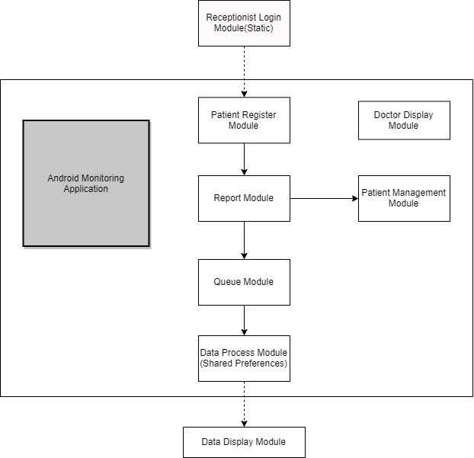
SysTEm ARCHITECTURE

Slide 8
Modules Involved:
The system consists of
Login Module
Add Patient details
Add queue details
Patient Report
Queue Display,
Doctor Details

Slide 9
Main concepts used:
Shared Preference: Shared Preference in Android are used to save data based on key-value pair. If we go deep into understanding.
Spinner: Spinner provides a quick way to select one value from a set of values. Android spinners are nothing but the drop down-list.
List View: List of scrollable items can be displayed in Android using ListView. It helps you to displaying the data in the form of a scrollable list. Users can then select any list item by clicking on it. ListView is default scrollable so we do not need to use scroll View or anything else with ListView.

Slide 10
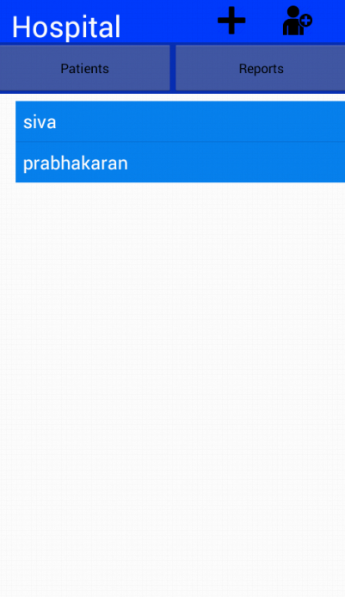
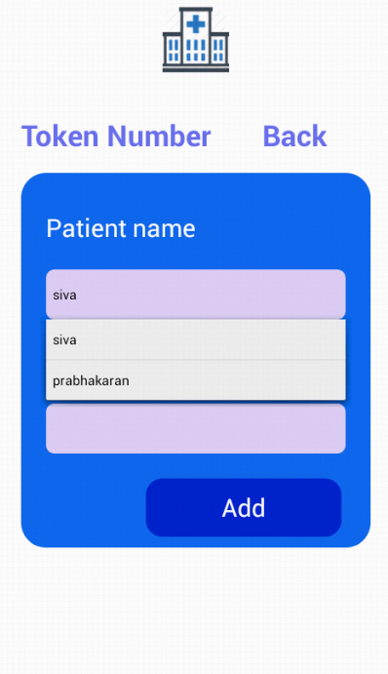
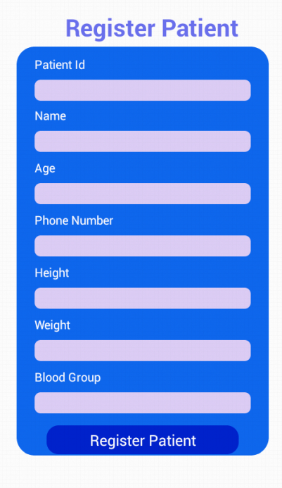
OUTPUT SCREENSHOT:

Slide 11
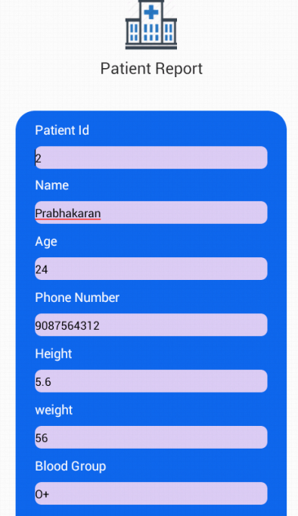
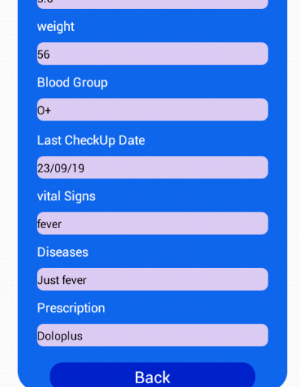
OUTPUT SCREENSHOT:

Slide 12
RESULTS AND DISCUSSIONS:
We developed an app for Clinic called Triage Clinic using the Android Programming.
It is very efficient for the patient and saves the time of the patient.
Doctor can view the patient report it consists of Height, Weight, Blood Presscure etc. According to that they can give their prescription.
This app can fit for any small clinic and reduce the manual work.

Slide 13
FUTURE WORK:
As far as our project is concern , we have just finished our front end of the project that is in the form of a mobile application.
In the future, we have planned to develop a database and merge the database with the front end application

